Slide 1
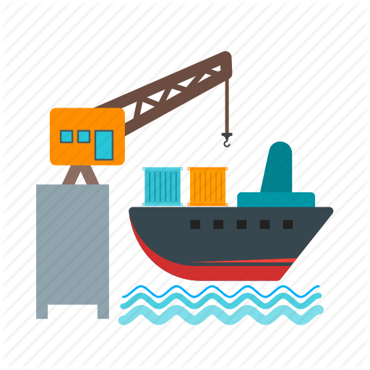
Getting started with docker
Khurram Raheel

Slide 2

Why User Docker?

Slide 3
It allows platform independent execution!

Slide 4

It allows platform independent execution!
Please explain it!

Slide 5


Ahmed is developing a web site using Windows

Slide 6


Ahmed is developing a web site using Windows
Ahmed’s client Rameez
is using waiting for his beautiful website to be delivered in a few hours.
Rameez uses Linux!

Slide 7

Now, since Ahmed’s development was different from Rameez’s machine, he may face too many issues while deploying the site

